Slide 1
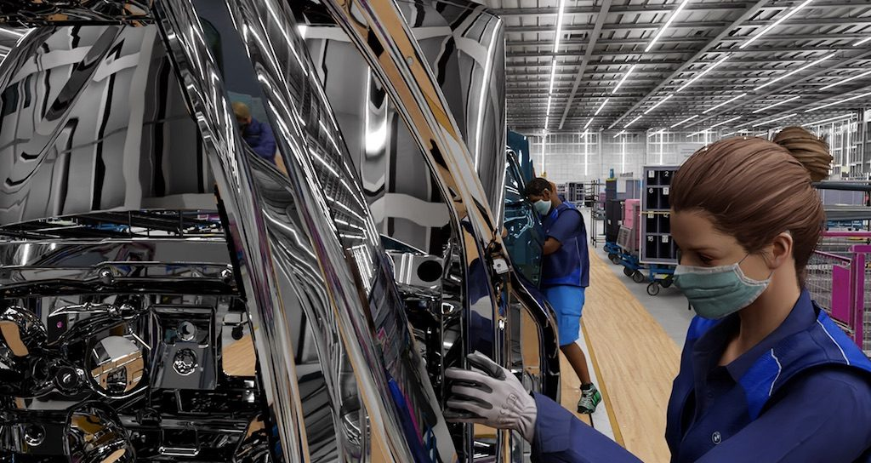
Synthetic Data Generation
for Machine Learning
Savelyev A.S. M107-22

Slide 2



Abstract
Oh no...
We have no enough data...
Just generate it,
Bruh...

Slide 3
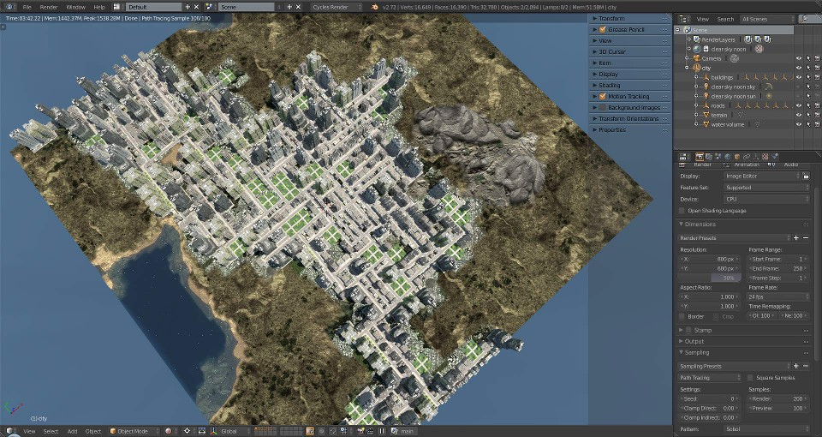
What is synthetic data
3D-Scene created
using City Generator

Slide 4
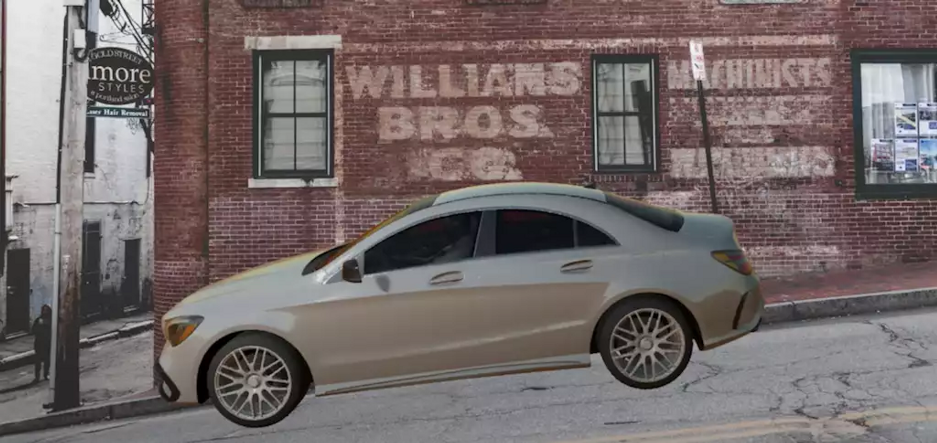
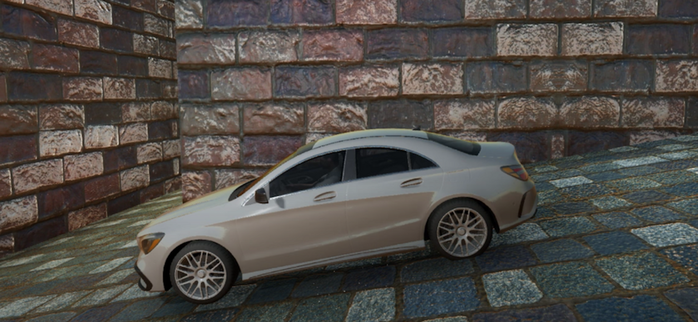
Types of
synthetic data
- Partial Type
Background is real,
car is not
- Full type
Background and car
is not real

Slide 5
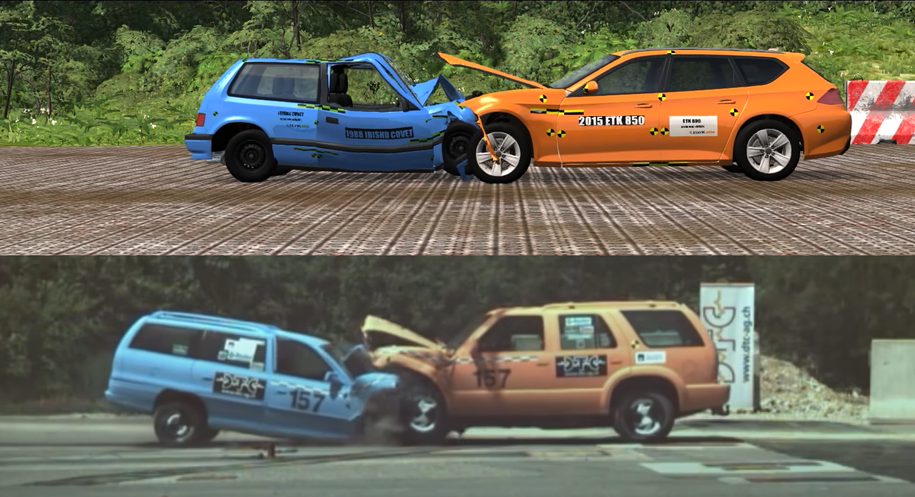
When and why synthetic data is used?

Slide 6


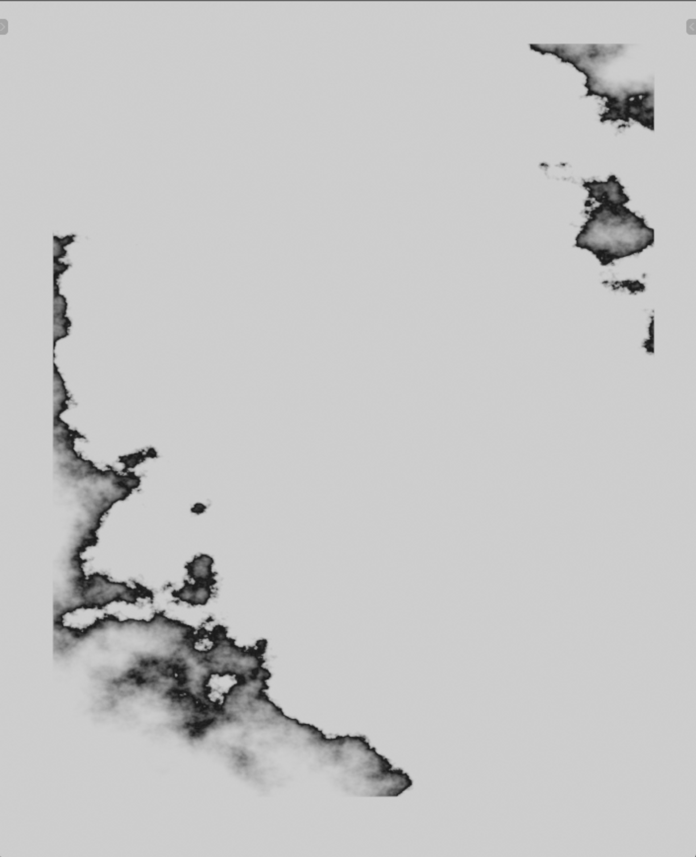
When and why synthetic data is used?
Unlabeled image
Labeled Alpha
Labeled Interlayer

Slide 7
When and why synthetic data is used?
Labeling like this
is so hard
Unlabeled image
Labeled Alpha
Labeled Interlayer

Slide 8
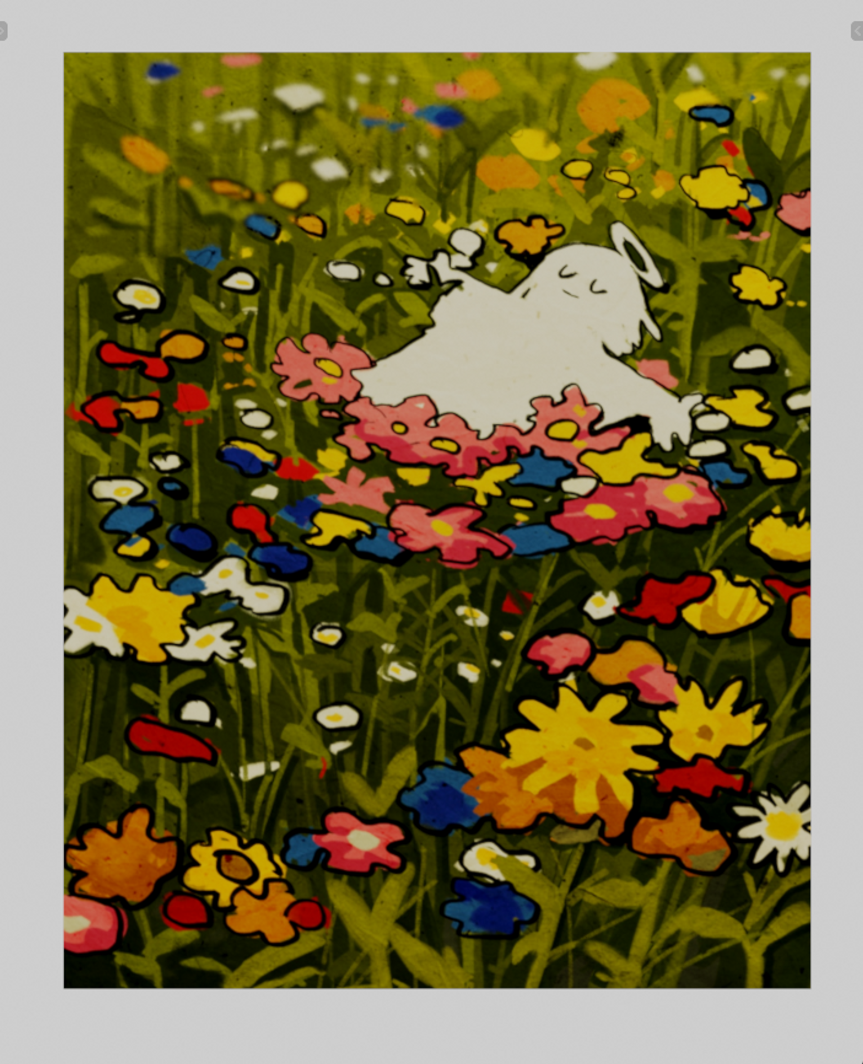
When and why synthetic data is used?
Generated image
Original image
Generated Alpha / Automatically labeled
Generated Interlayer / Automatically labeled

Slide 9
When and why synthetic data is used?
Labeling like this
is so easy
Generated image
Original image
Generated Alpha / Automatically labeled
Generated Interlayer / Automatically labeled

Slide 10


Tabular synthetic data
Im a person and
my data is pesonal!
No problem, we use
tabular data generator

Slide 11


Text synthetic data
This Chatbot
is so cool
We trained him
on synthetic text data

Slide 12
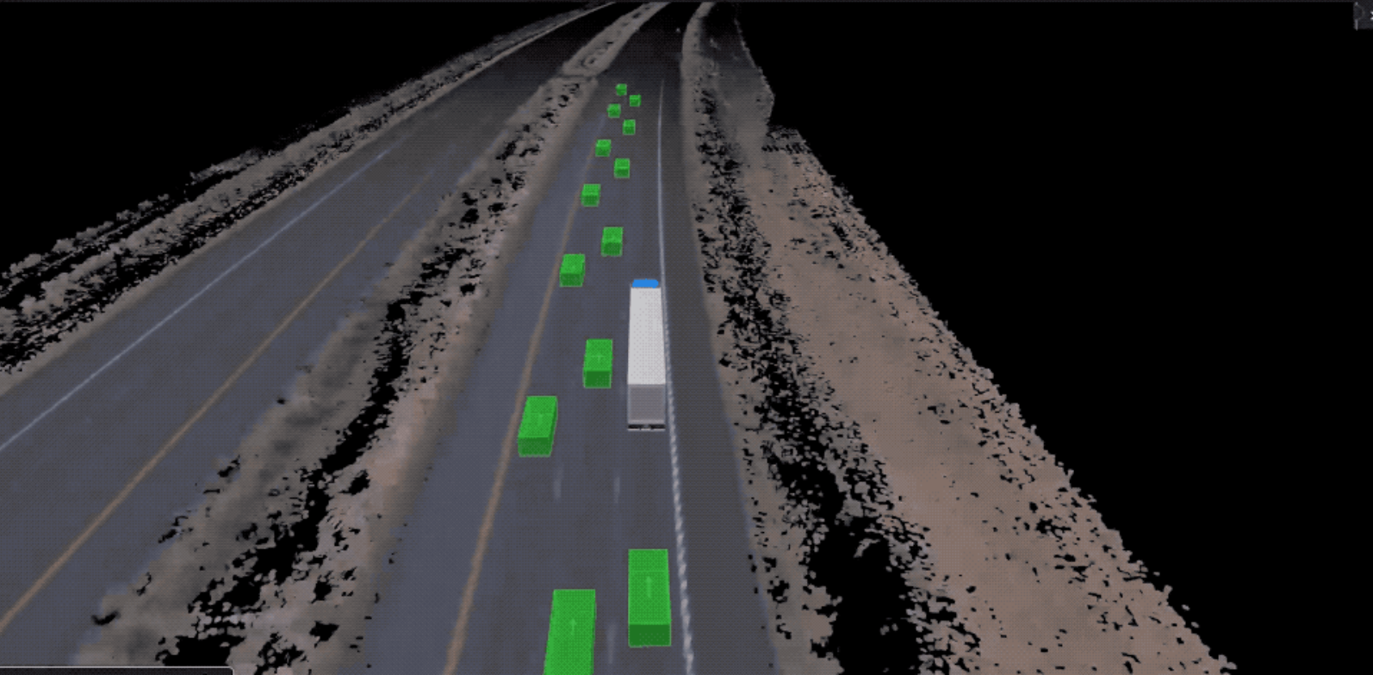
Self-driving vehicles
by Waymo
In this environment, a vehicle is trained on labeled synthetic data along with real data to drive safely, while recognizing objects and following traffic rules.

Slide 13
Virtual factory facility
by NVIDIA x BMW
In this environment, a vehicle is trained on labeled synthetic data along with real data to drive safely, while recognizing objects and following traffic rules.

Slide 14
Synthetic data is cool

Slide 15
Thanks for your attention

